Slide 1
Concurrency
Saint Petersburg, 2019

Slide 2
Content
1
Hardware basics
2
Software basics
3
Java thread management
4
Concurrency general concept
5
Java concurrency implementation
6
Conclusion

Slide 3
Hardware basics

Slide 4
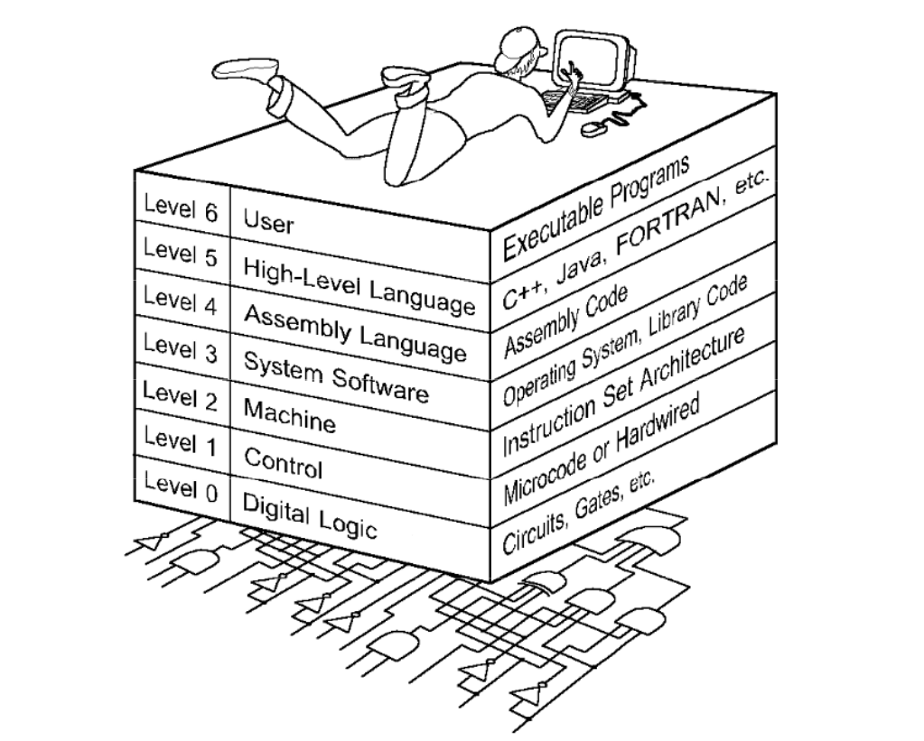
The World we are living in

Slide 5
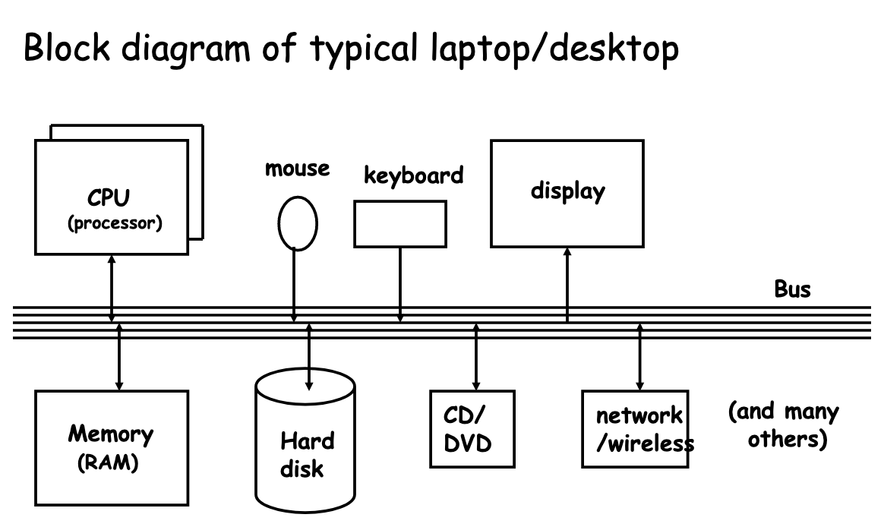
Computer architecture

Slide 6
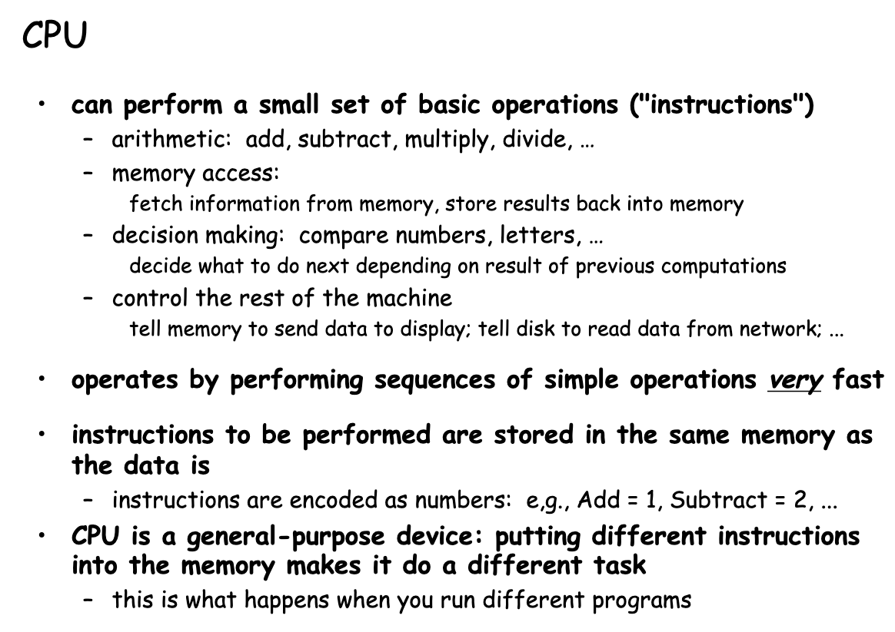
CPU

Slide 7
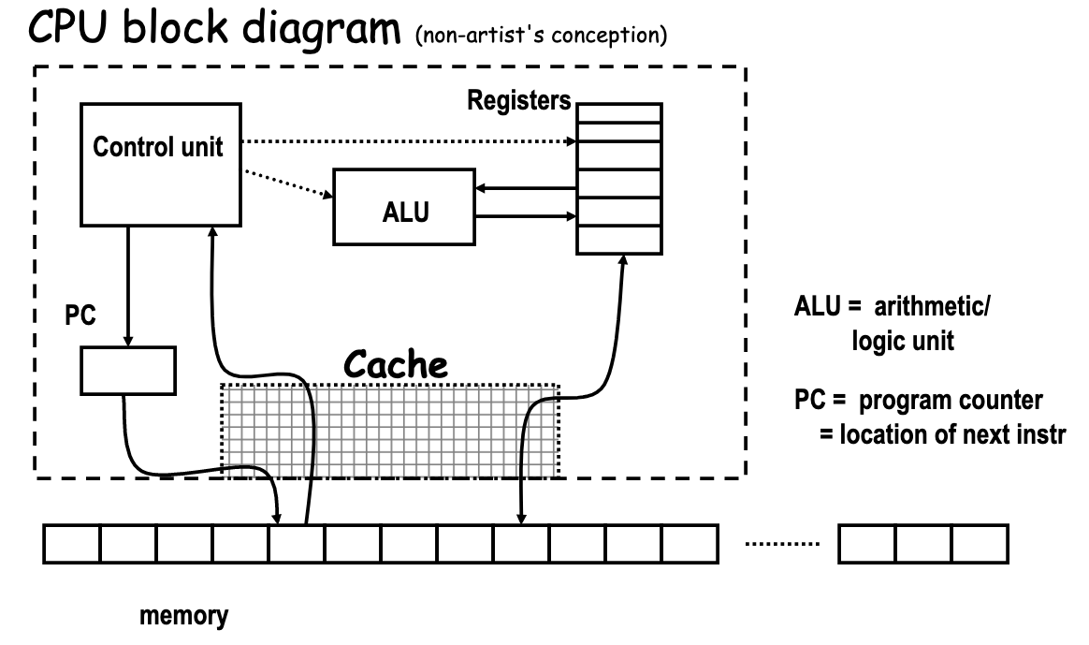
CPU

Slide 8
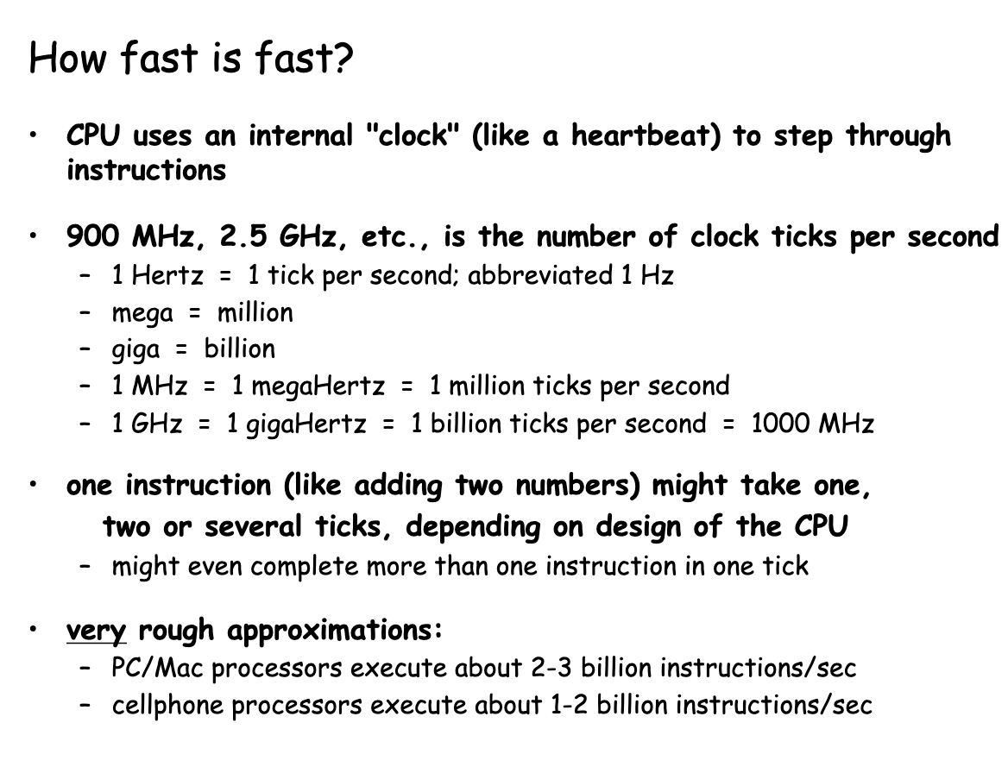
CPU

Slide 9
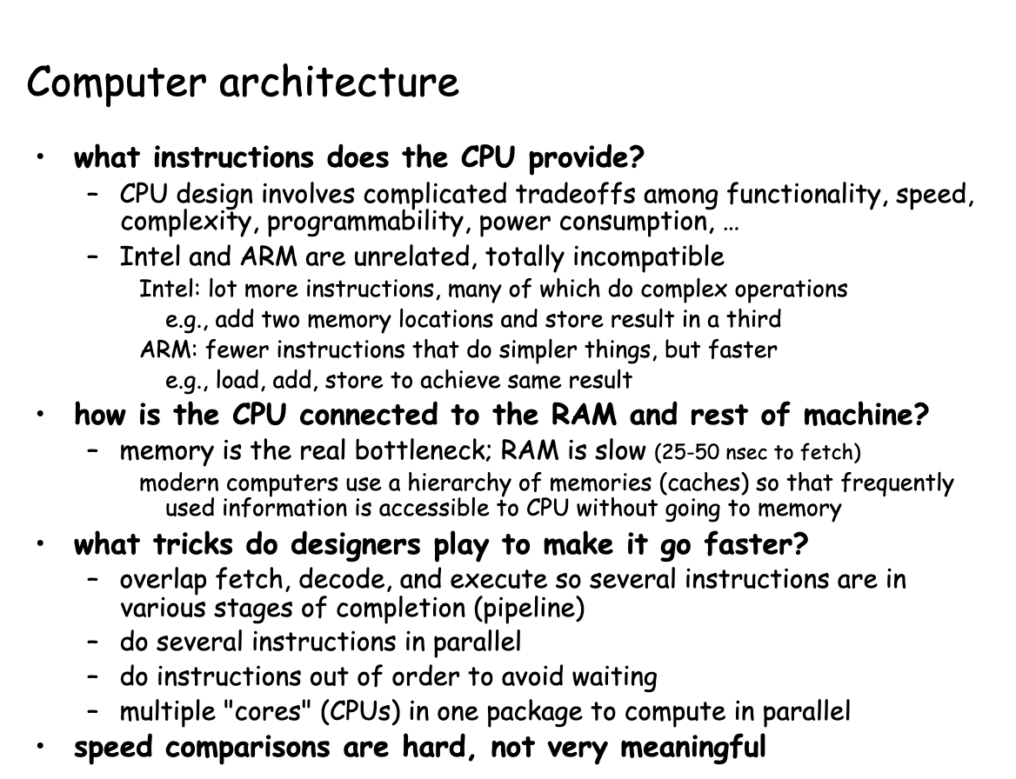
Computer architecture

Slide 10
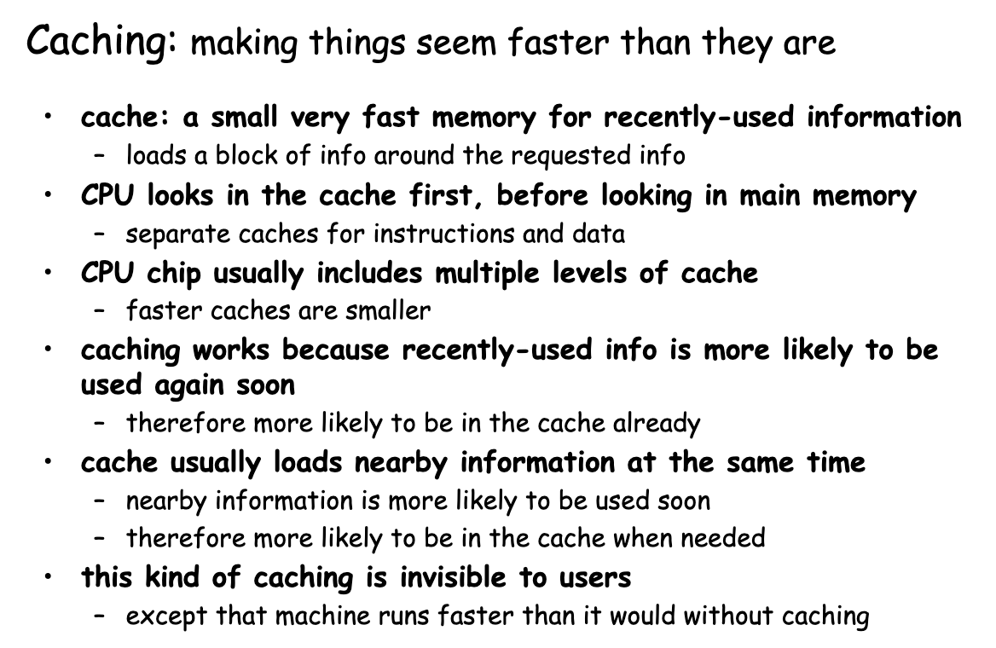
CPU architecture

Slide 11
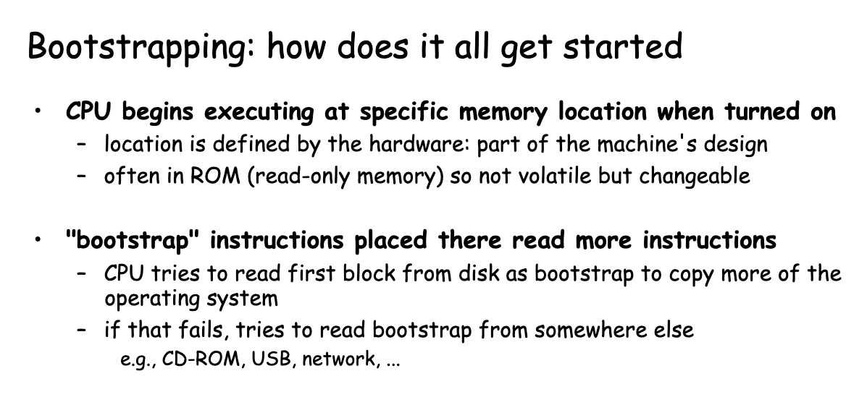
Bootstrapping

Slide 12
Software basics

Slide 13
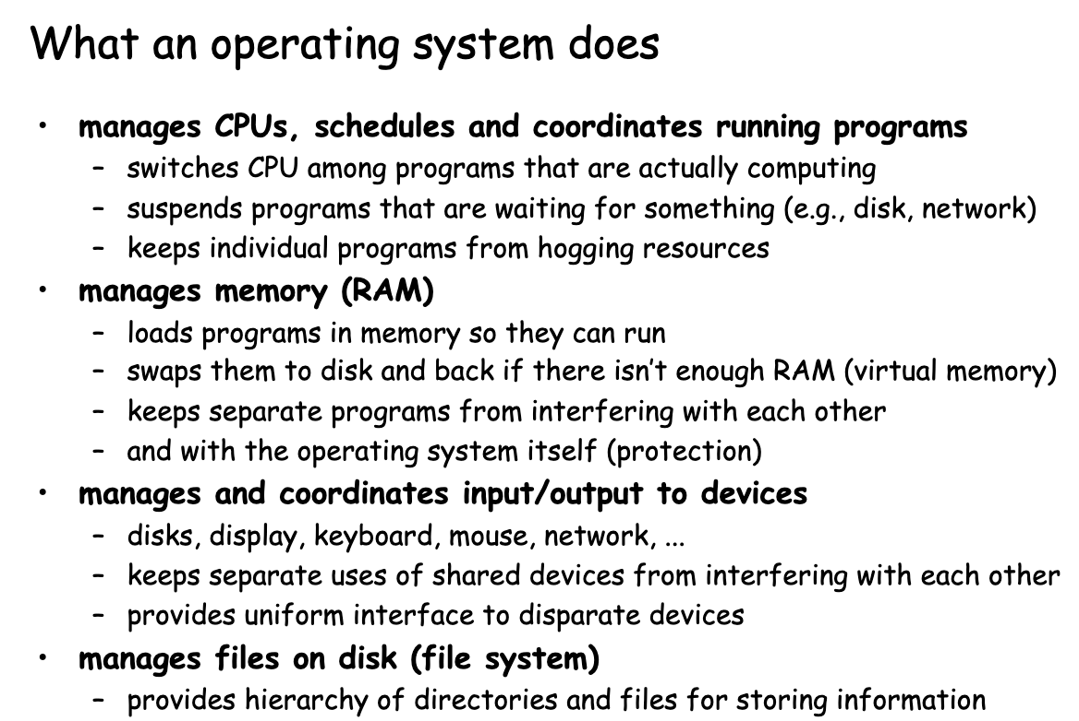
OS

Slide 14
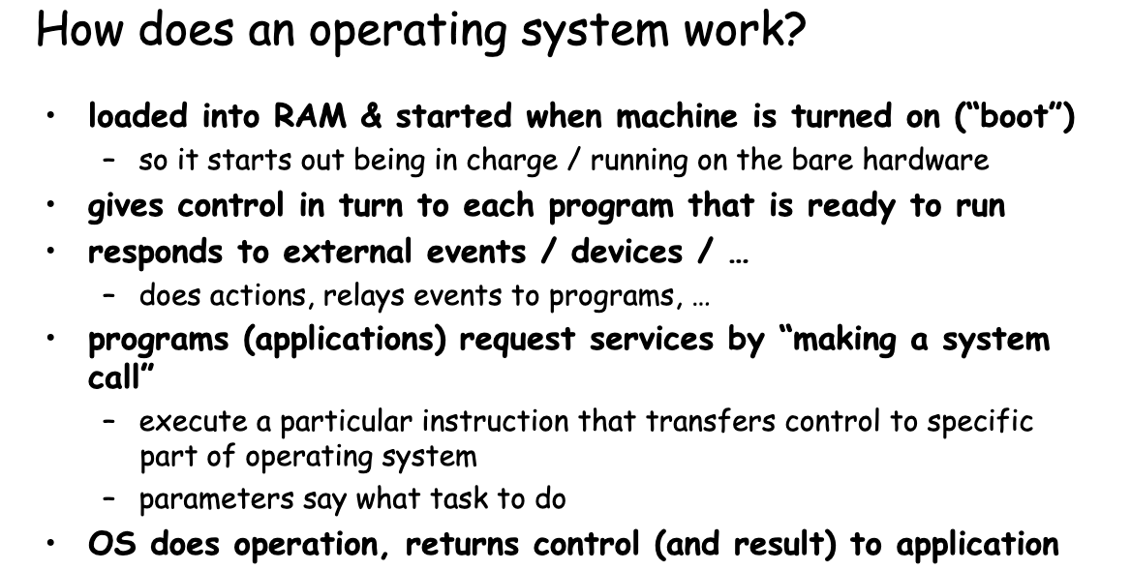
OS

Slide 15
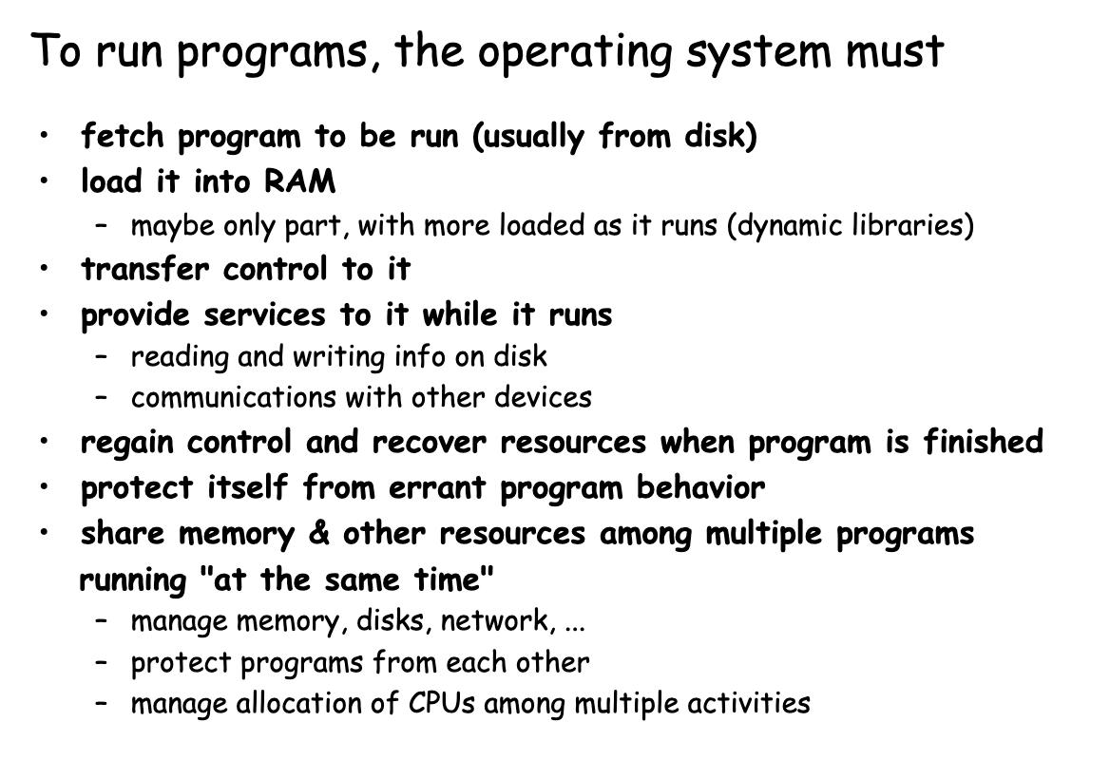
How to run programs?

Slide 16
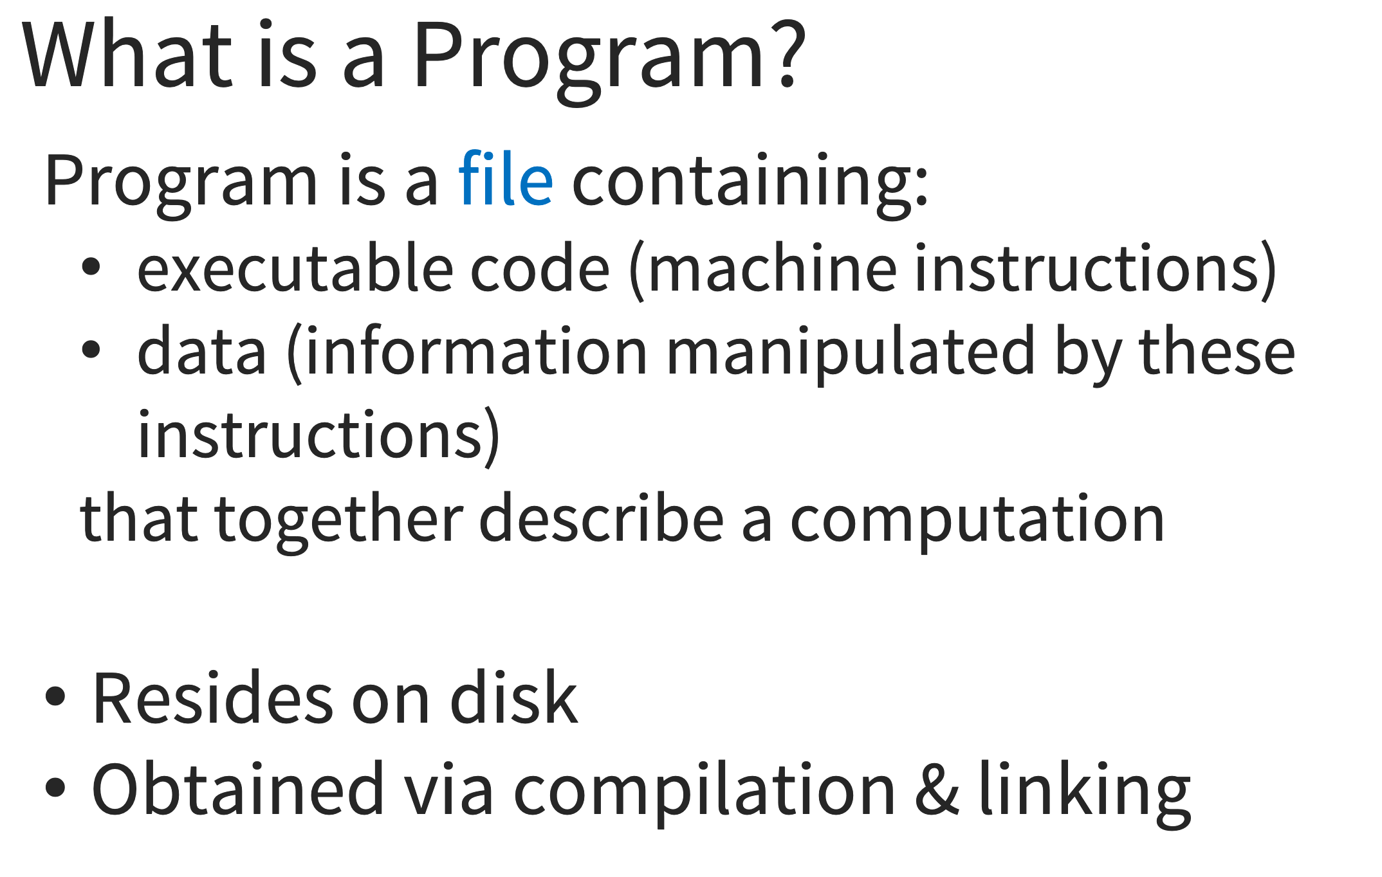
Programs

Slide 17
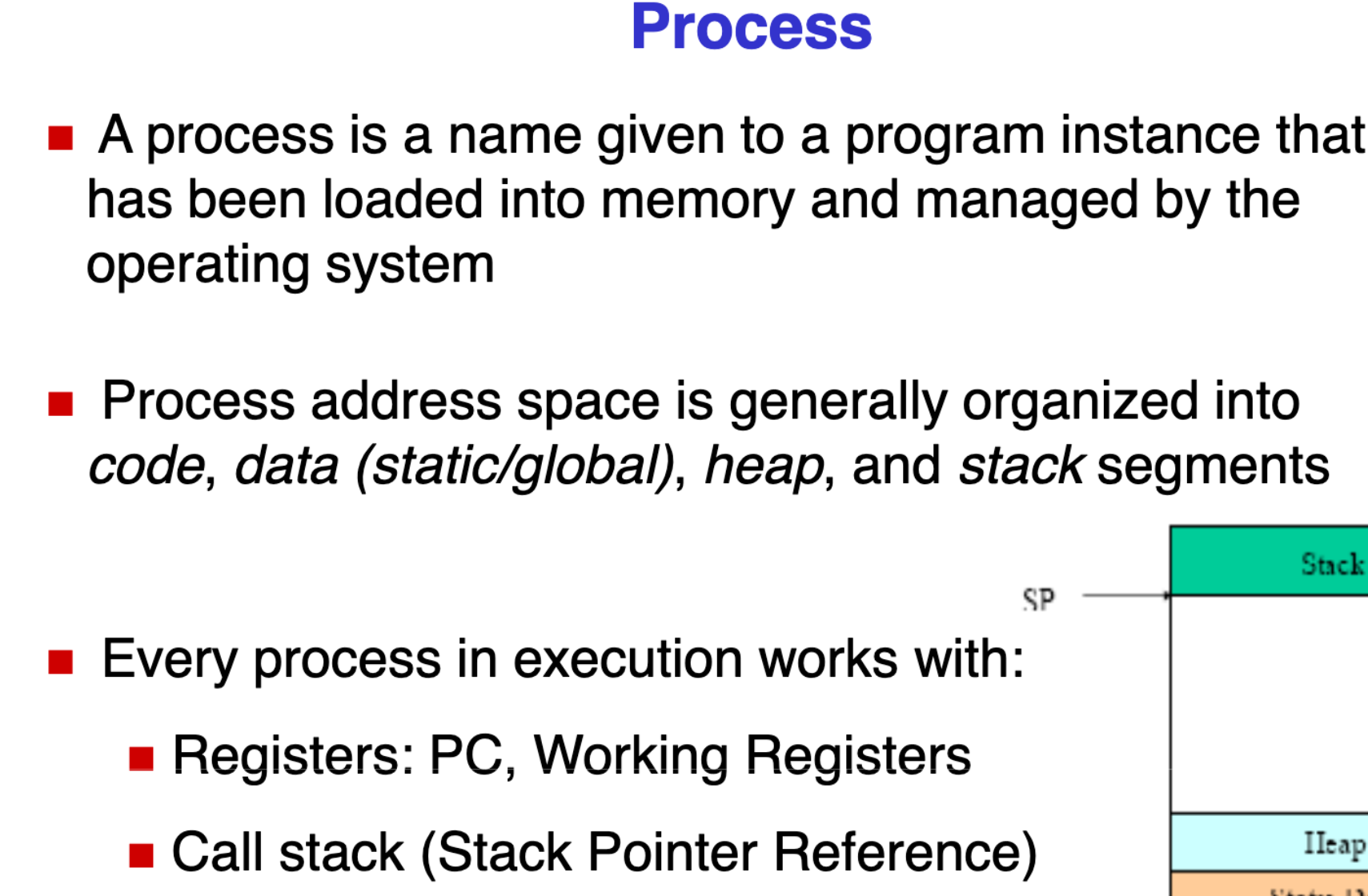
Process

Slide 18
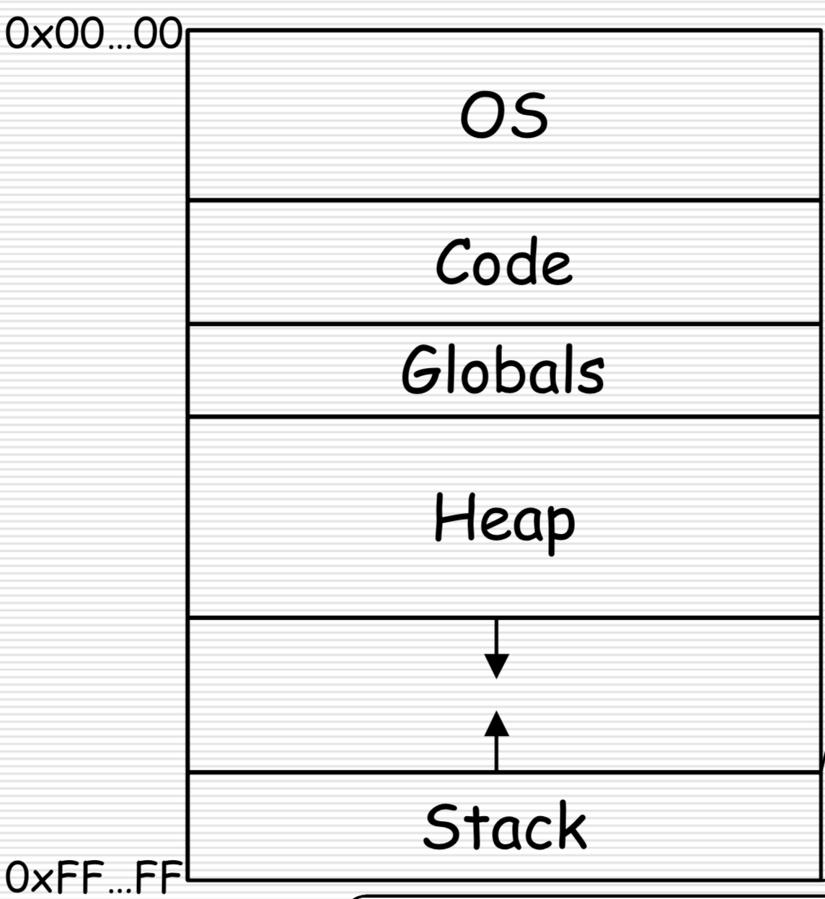
Process

Slide 19
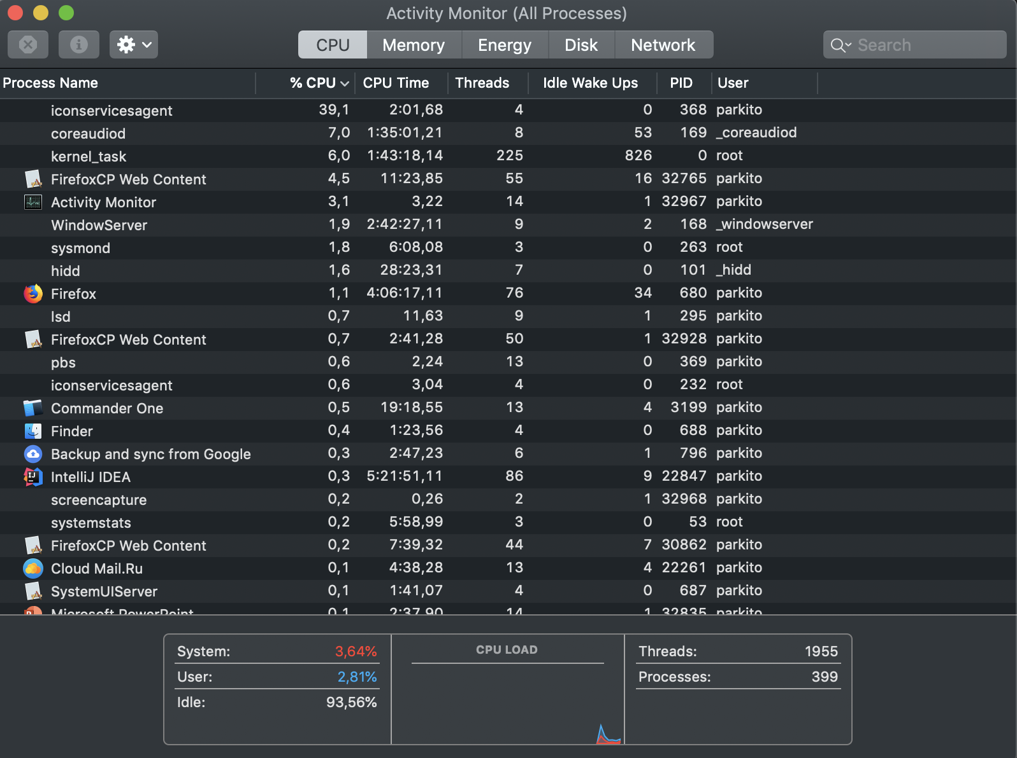
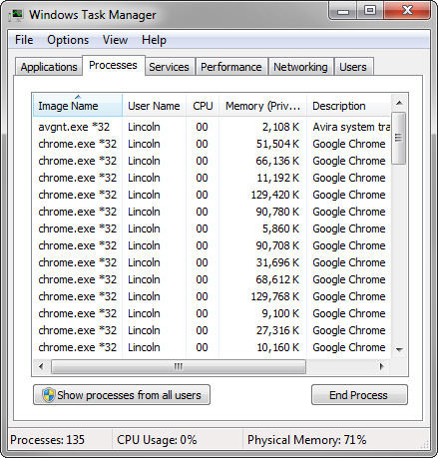
Processes

Slide 20
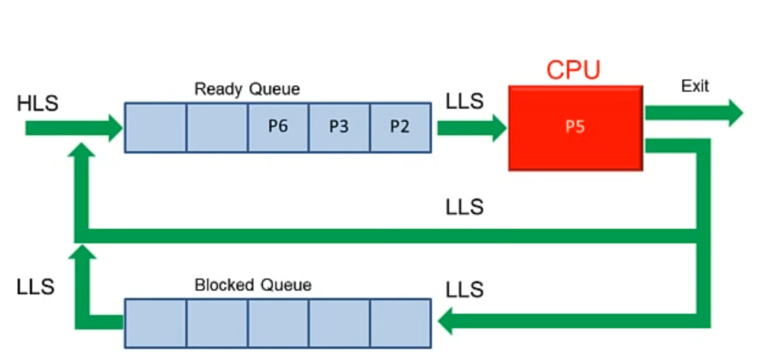
How processors work?

Slide 21
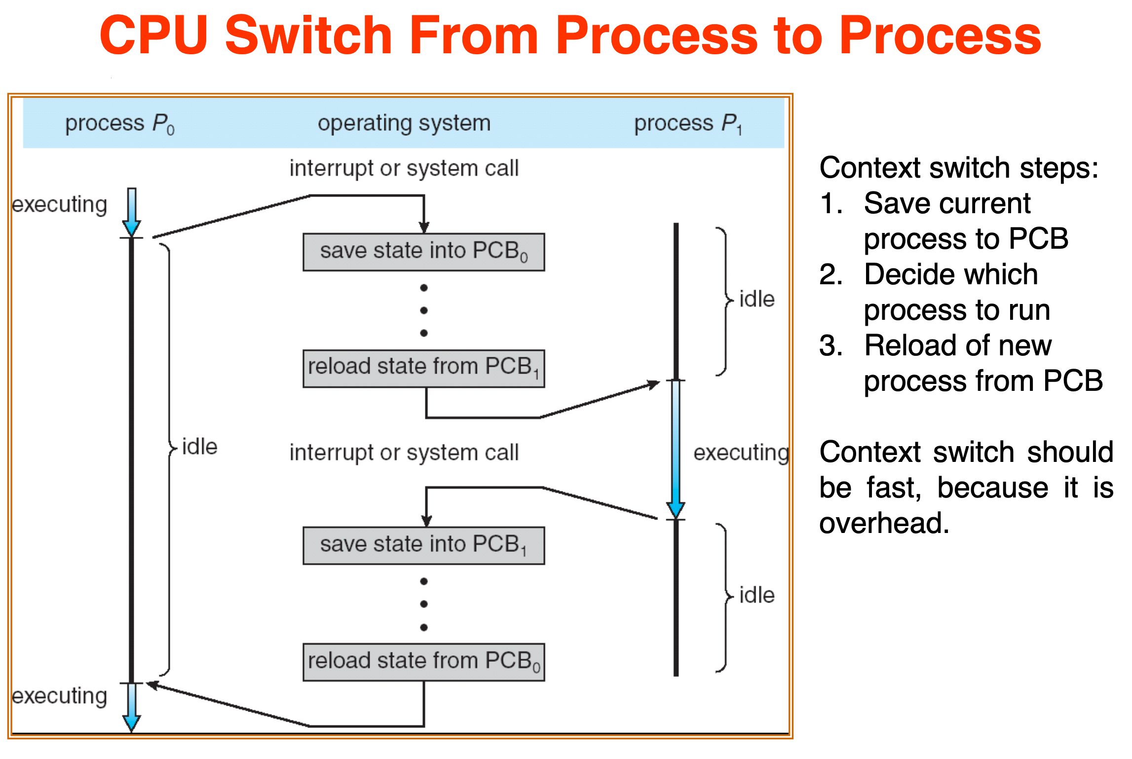
How processors work?

Slide 22
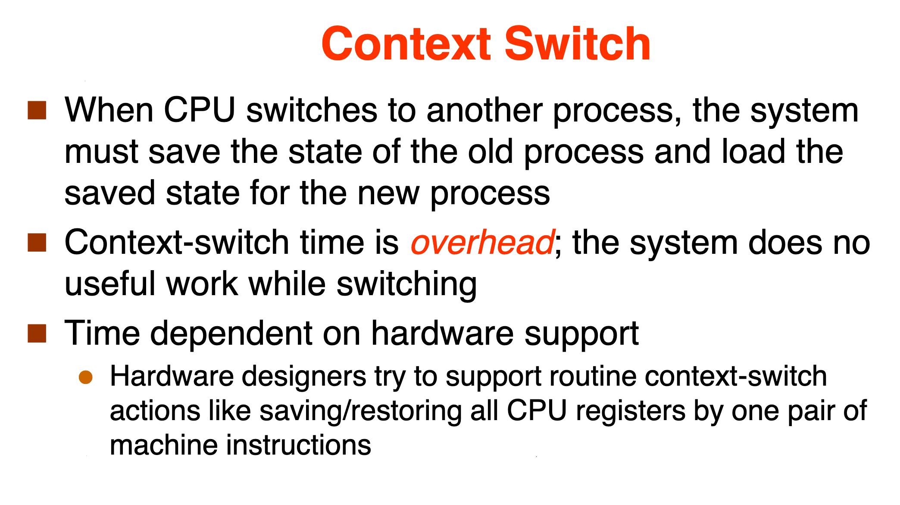
How processors work?

Slide 23
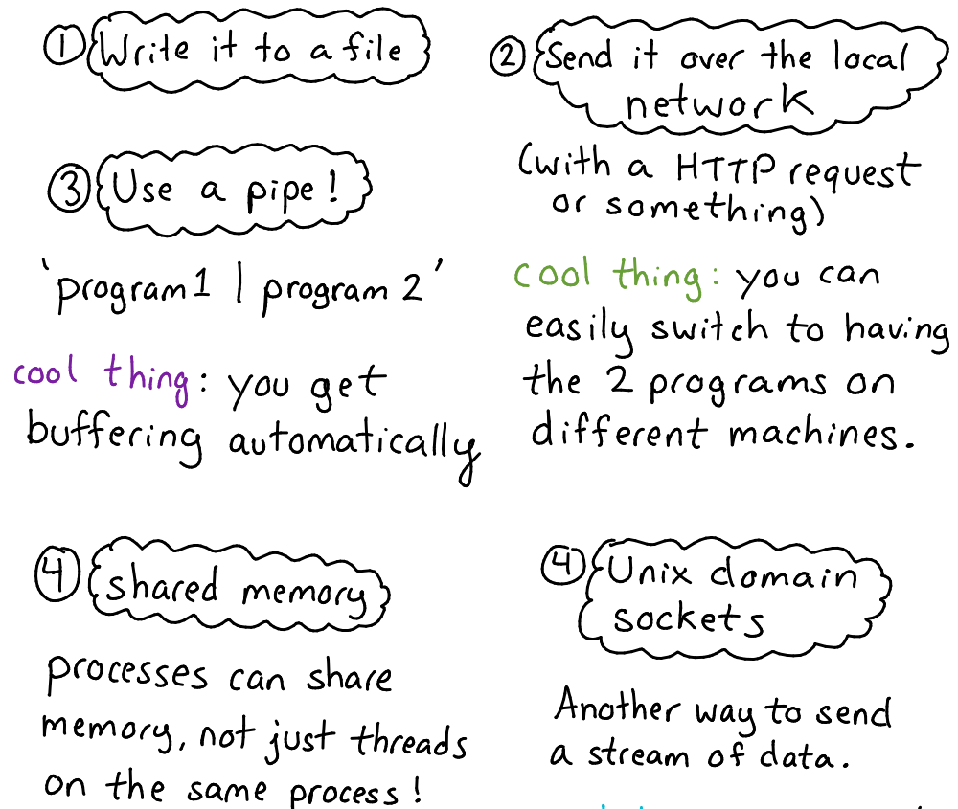
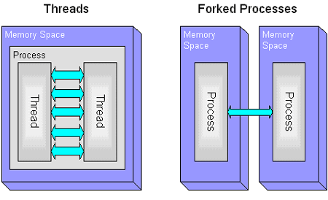
Inter-process communications

Slide 24
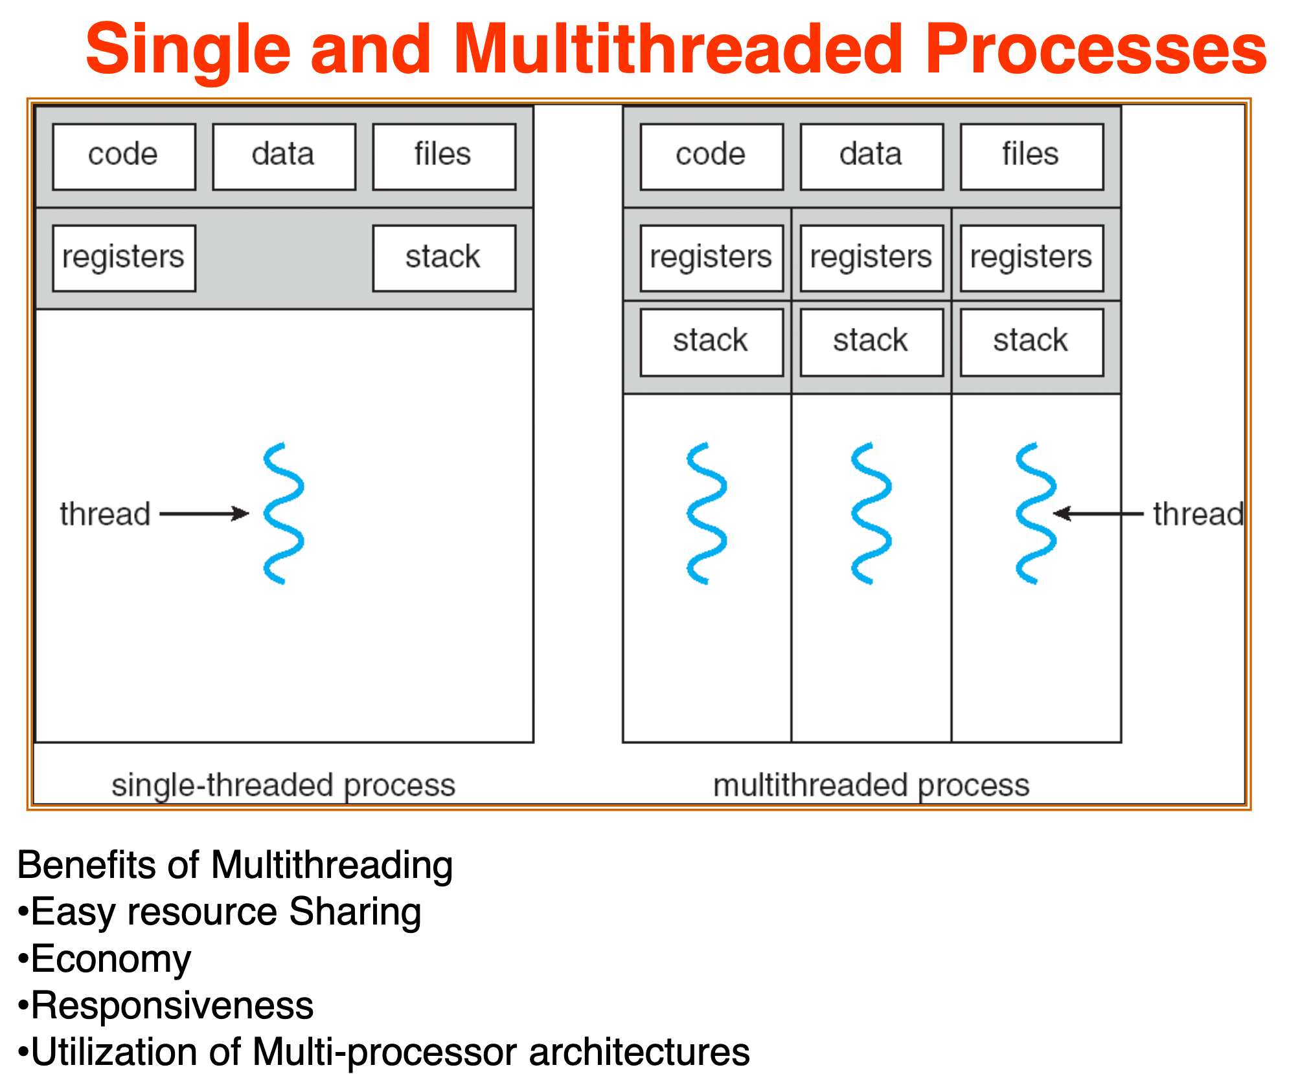
Threads

Slide 25
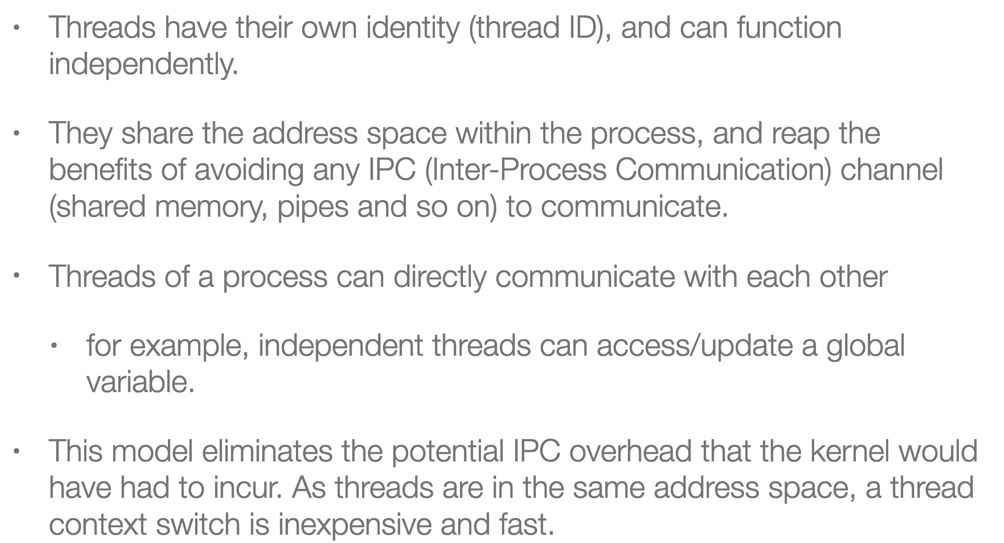
Threads

Slide 26
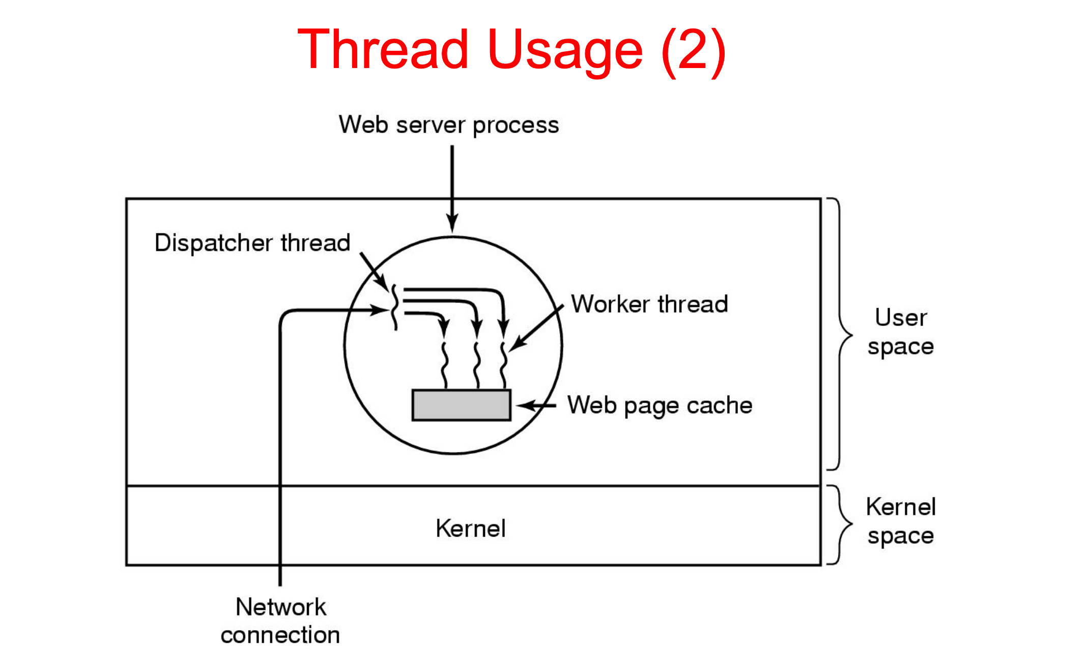
How processors work?

Slide 27
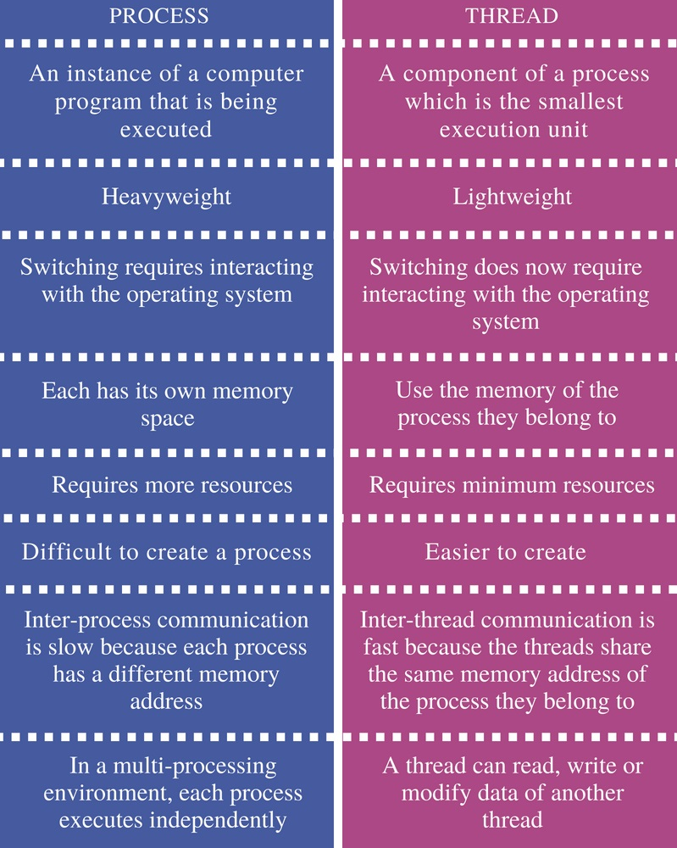
Inter-process communications

Slide 28
Java basics

Slide 29
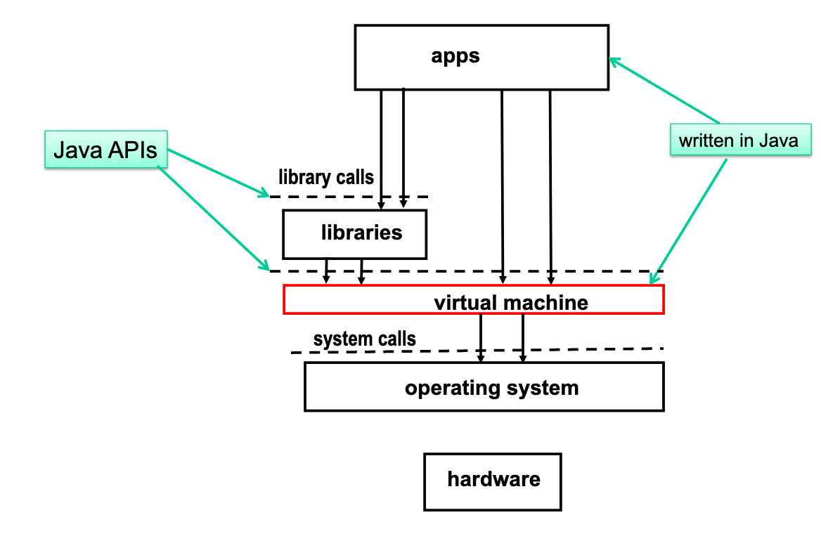
JVM execution architecture

Slide 30
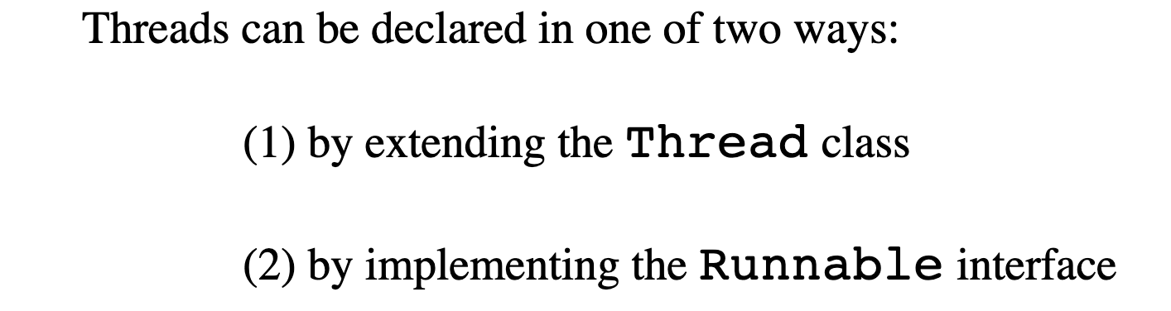
JVM execution architecture

Slide 31
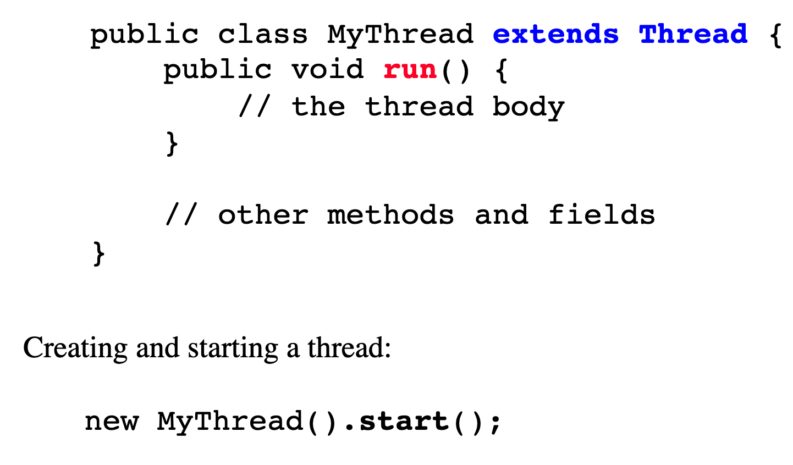
JVM execution architecture

Slide 32
JVM execution architecture

Slide 33
Example 1,2,3

Slide 34
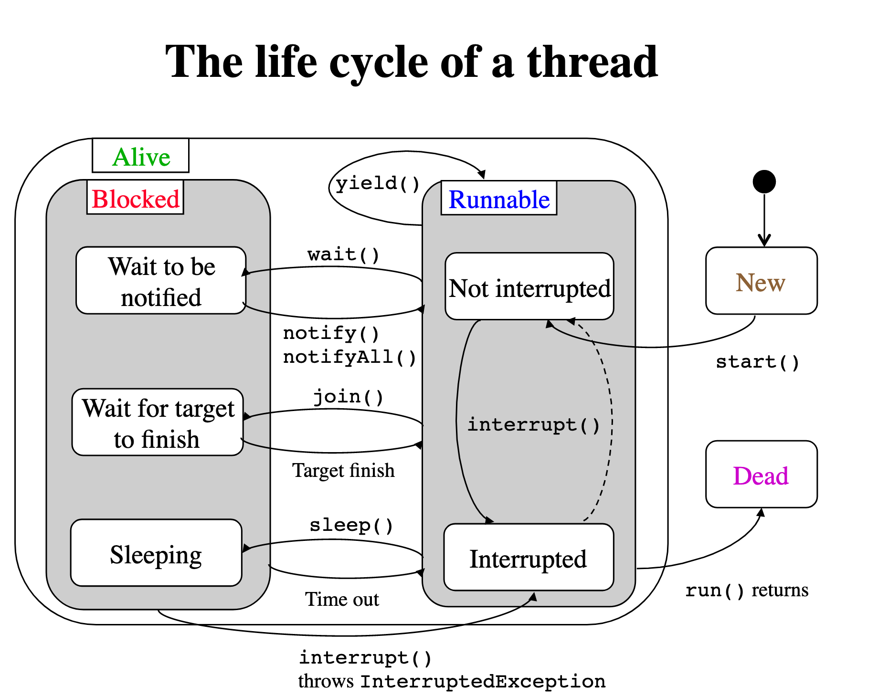
JVM execution architecture

Slide 35
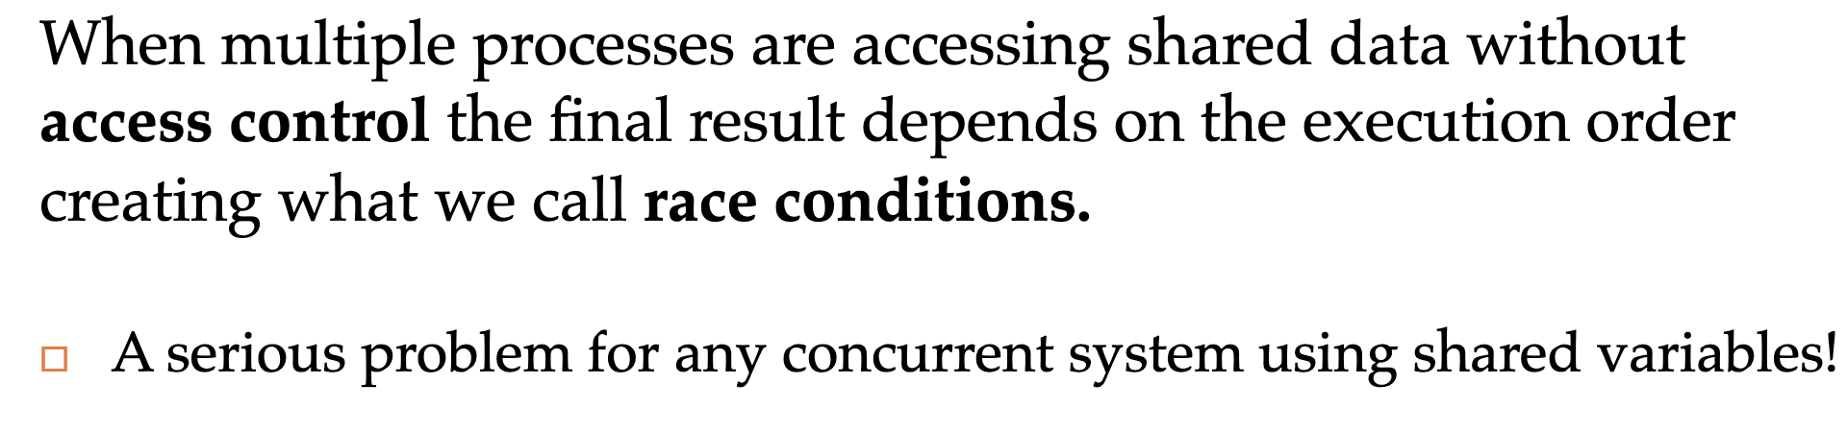
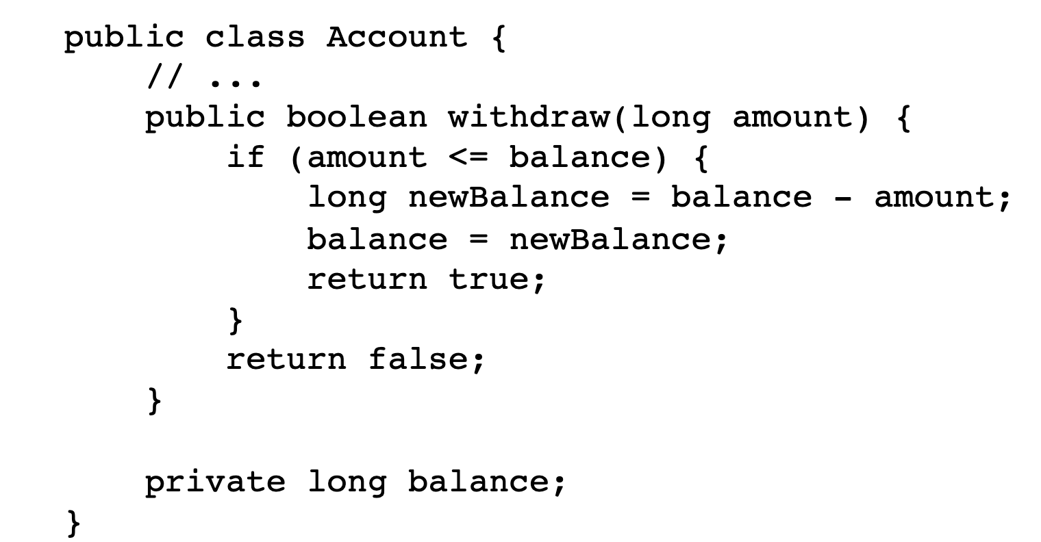
JVM execution architecture

Slide 36
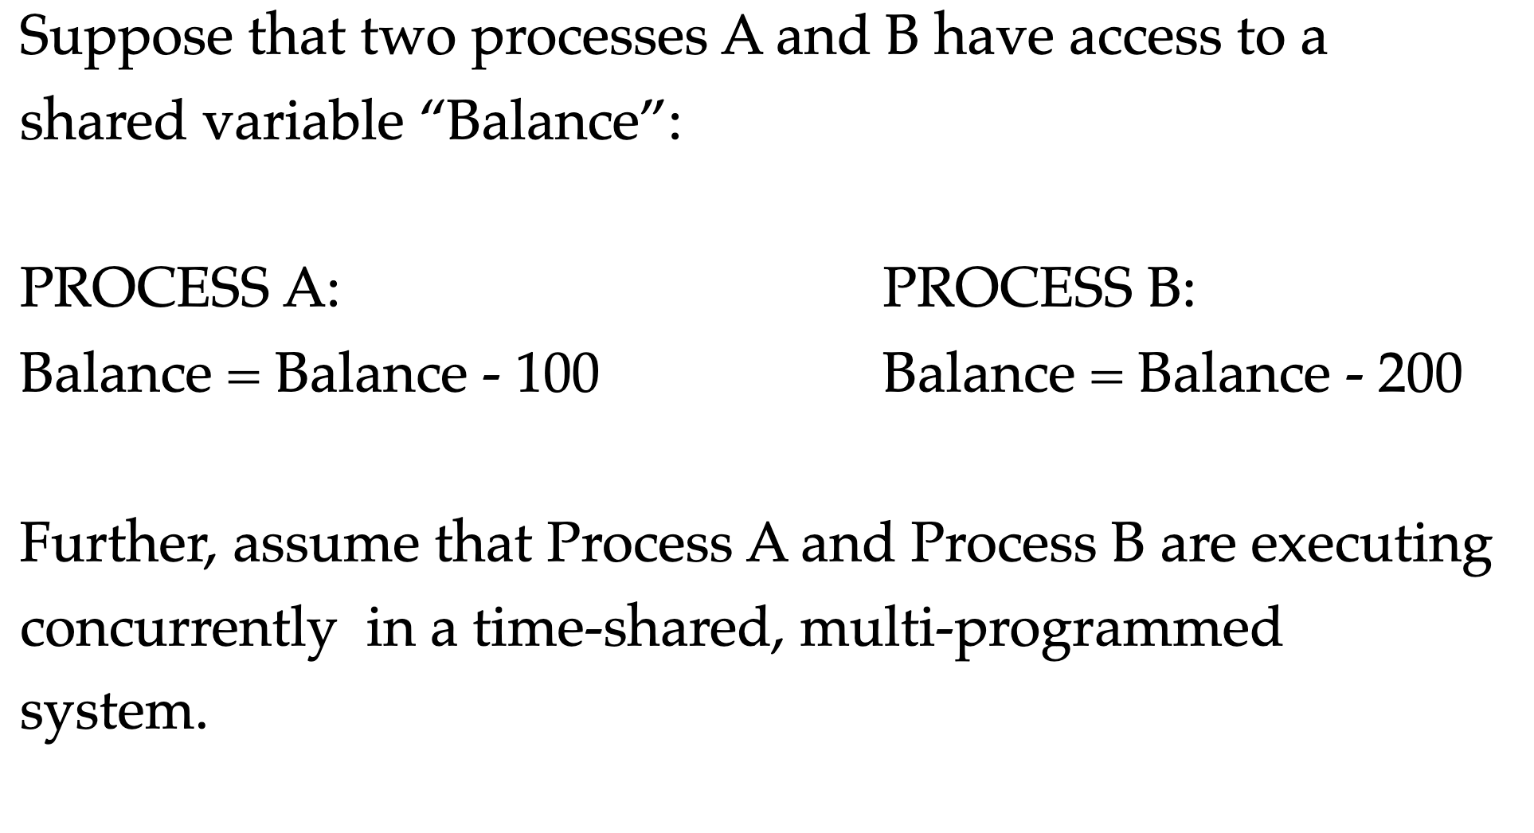
JVM execution architecture
threads
Thread A:
Thread B:
Thread
Thread

Slide 37
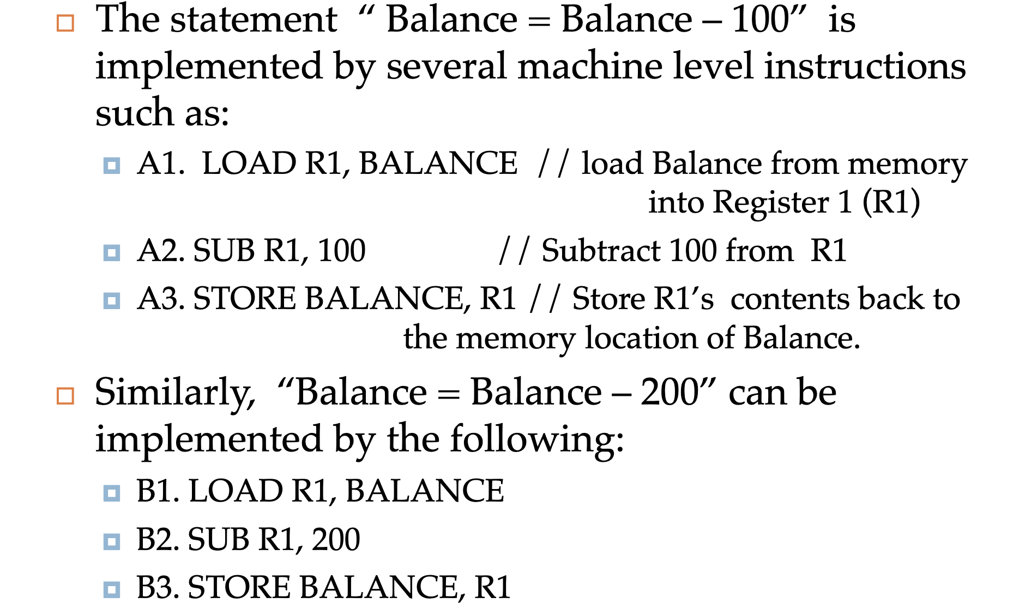
JVM execution architecture

Slide 38
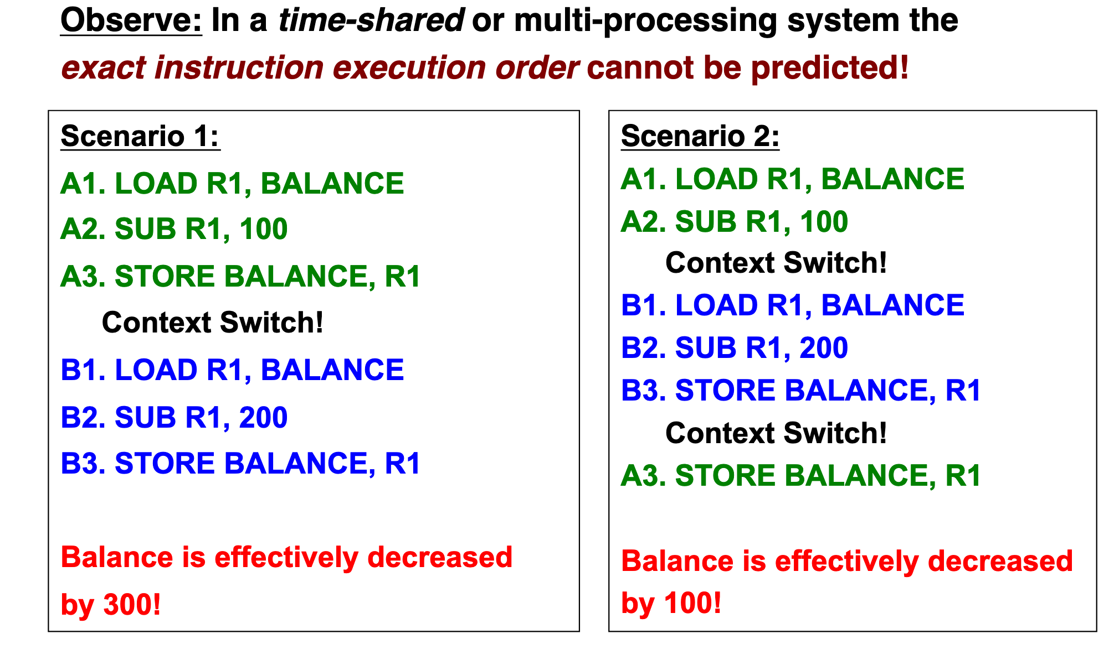
JVM execution architecture

Slide 39
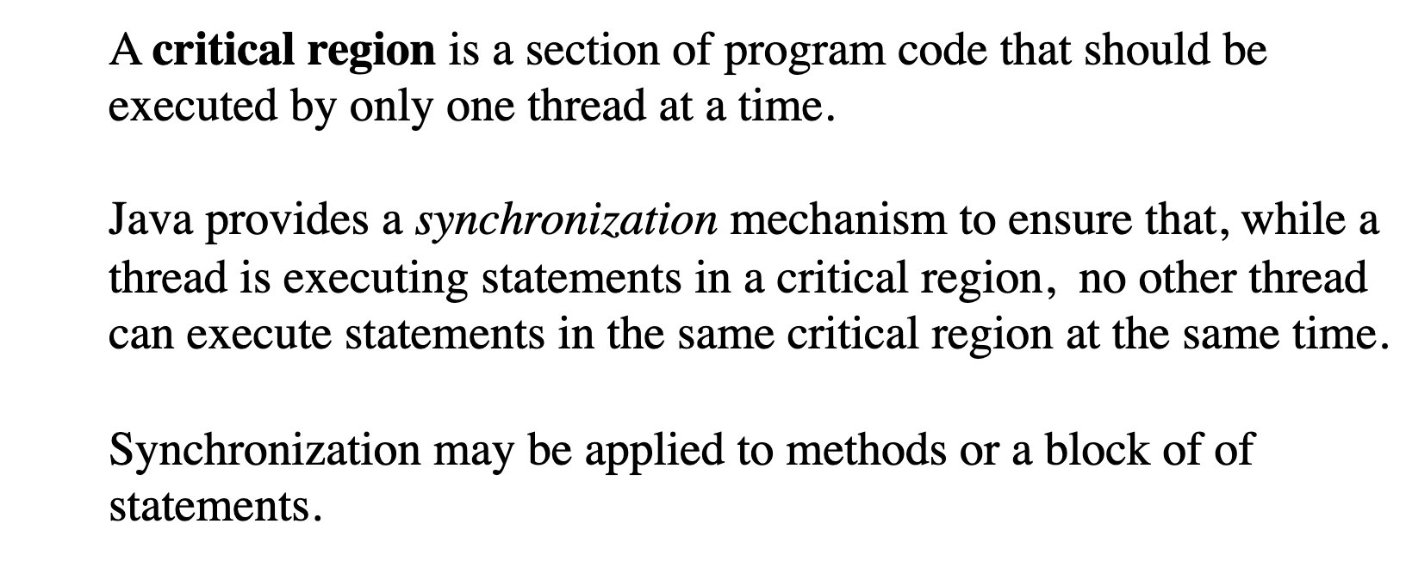
Critical region(section)

Slide 40
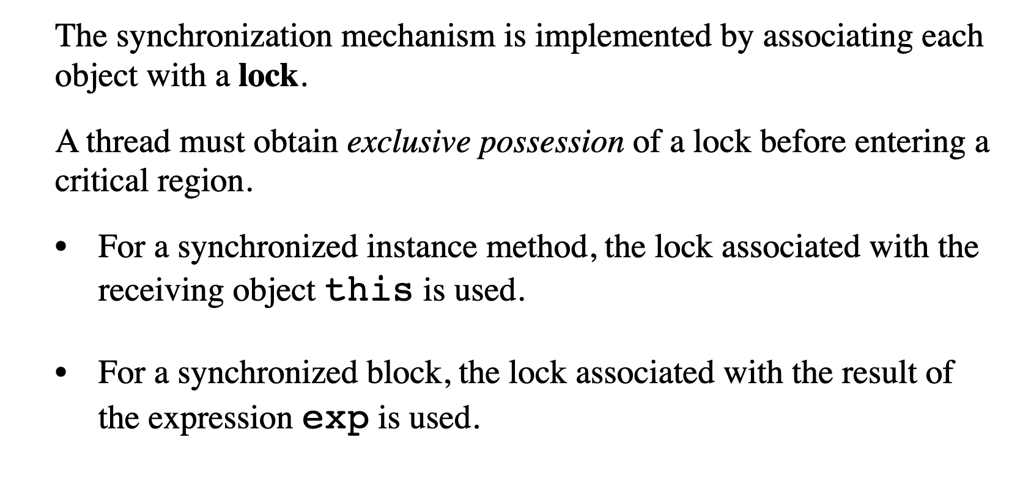
Lock (monitor)

Slide 41
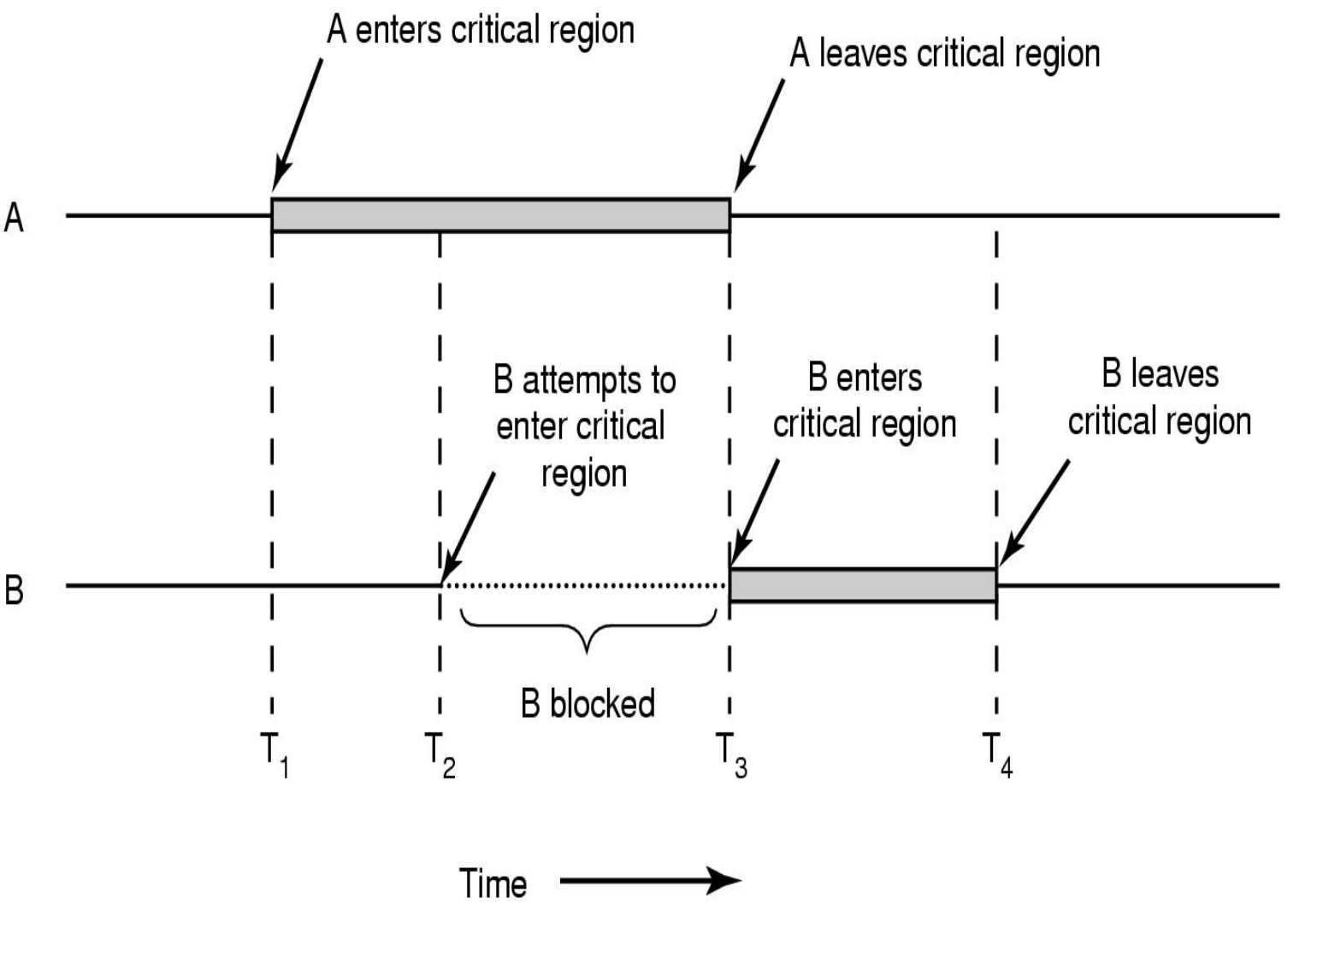
JVM execution architecture

Slide 42
Example 4

Slide 43
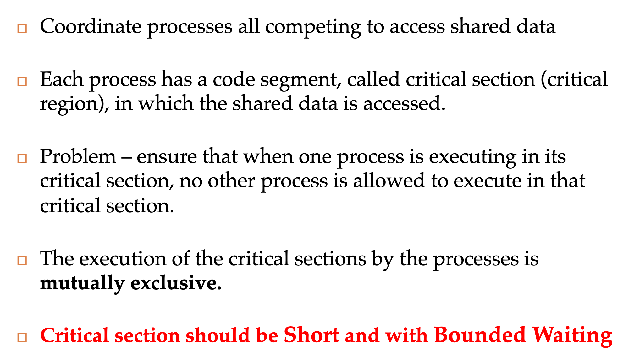
JVM execution architecture

Slide 44
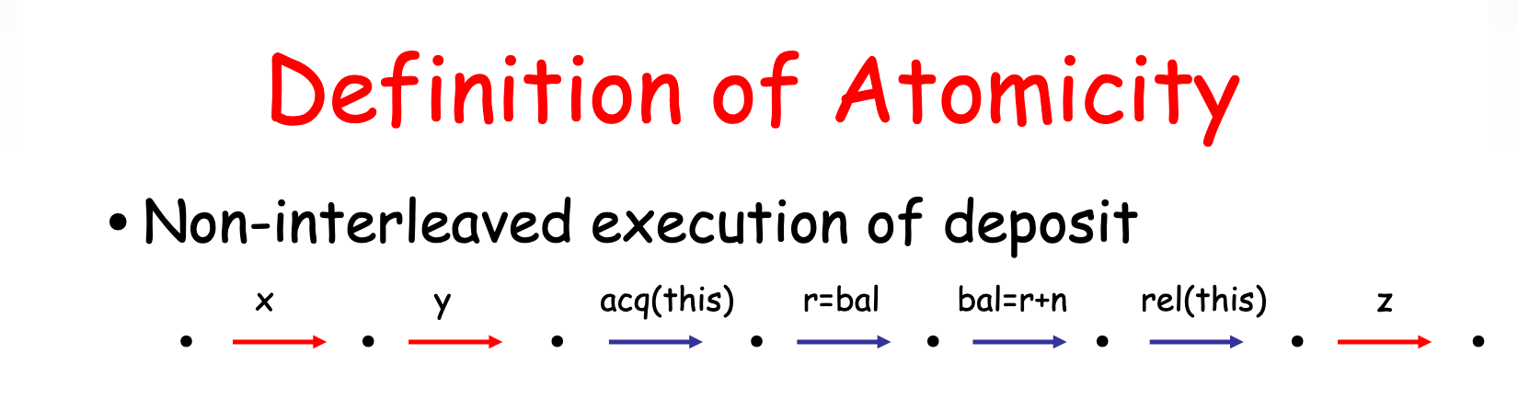
Atomicity

Slide 45
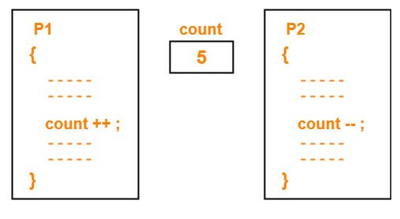
Atomicity

Slide 46
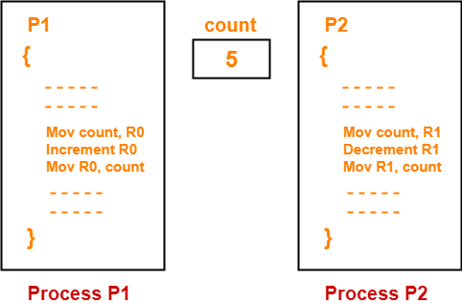
Atomicity

Slide 47
CPU

Slide 48
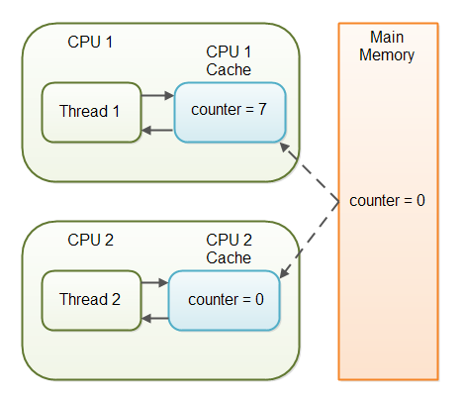
Visibility

Slide 49
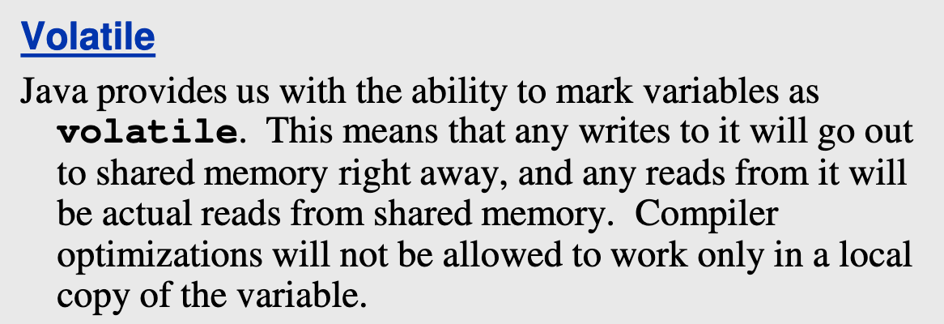
Visibility

Slide 50
Example 5

Slide 51
How processors work?

Slide 52
Concurrent computing is a form of computing in which several computations are executed during overlapping time periods—concurrently—instead of sequentially (one completing before the next starts)
Definition

Slide 53
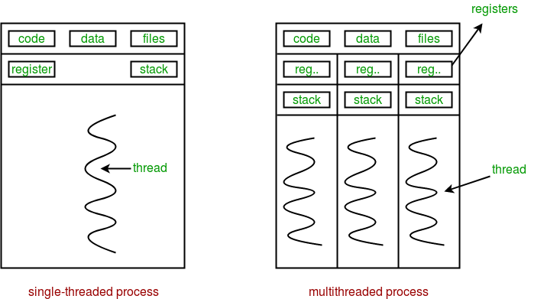
Sequential vs concurrent

Slide 54
Performance

Slide 55
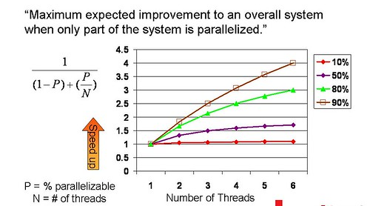
Amdahl's law

Slide 56
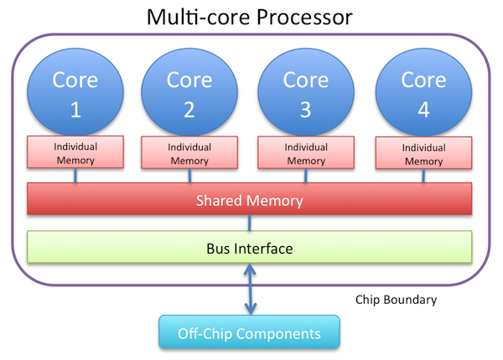
Resource utilization

Slide 57
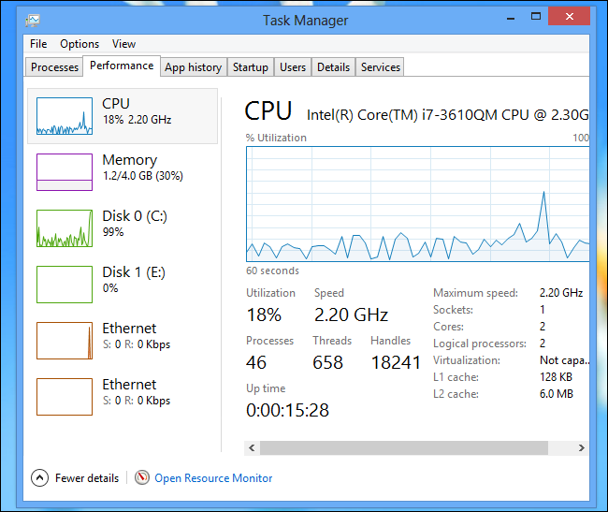
Resource utilization

Slide 58
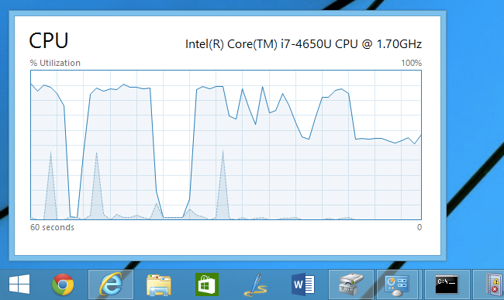
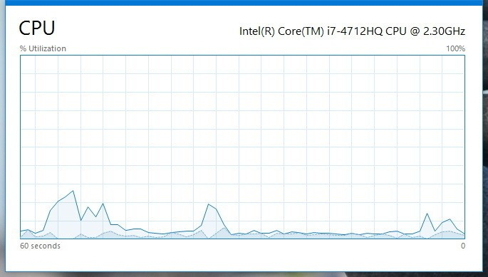
Resource utilization

Slide 59
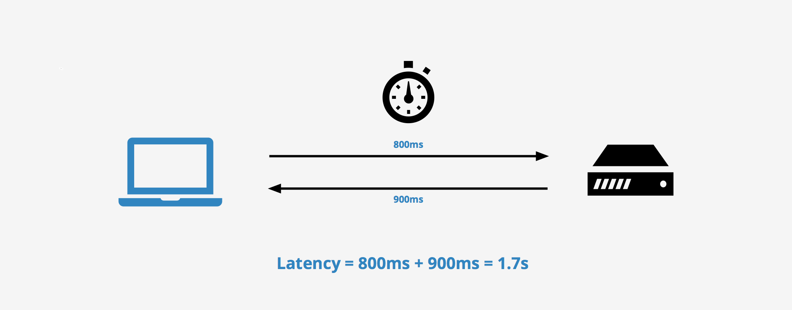
Latency

Slide 60

Modern way

Slide 61






Concurrent Dijkstra algorithm

Slide 62
Multi thread migration

Slide 63
Single thread migration
7h21 min 1.7 r/s

Slide 64
Multi thread migration

Slide 65
Multi thread migration
7h21 min 1.7 r/s
28 min 23 r/s

Slide 66

The show begins

Slide 67

#1 Difficult to debug

Slide 68

#2 Race condition

Slide 69

#3 Dead locks

Slide 70
Concurrency mad stuff
“But I don’t want to go among mad people," Alice remarked. - "Oh, you can’t help that," said the Cat: "we’re all mad here. I’m mad. You’re mad." - "How do you know I’m mad?" said Alice. - "You must be," said the Cat, "or you wouldn’t have come here.”
Alice's Adventures in
Wonderland by Lewis Carroll

Slide 71


Dev practices
On Java 8 by Bruce Eckel

Slide 72


Dev practices
On Java 8 by Bruce Eckel

Slide 73

#4 Non deterministic behavior

Slide 74

#4 Non deterministic behavior

Slide 75

#4 Non deterministic behavior

Slide 76

#4 Non deterministic behavior

Slide 77
Are you still here?
Twas brillig, and the slithy toves Did gyre and gimble in the wabe: All mimsy were the borogoves, And the mome raths outgrabe
Jabberwocky by Lewis Carroll

Slide 78

Let’s continue?

Slide 79

#5 Performance degradation

Slide 80

#5 Performance degradation

Slide 81

#6 OS limitation

Slide 82

Stop it? Hell no…

Slide 83

#7 Hardware unpredictable optimizations

Slide 84

Concurrency in real world
On Java 8 by Bruce Eckel

Slide 85
Conclusion
Concurrency is powerful practice, you can achieve a lot using it
Don’t use concurrency if you can avoid it
Use best practices by experts
Use frameworks with big professional community
Minimize synchronization and data sharing
Perform load and stress testing
Use as much as possible existed solutions
Don’t forget about mad world and wonders

Slide 86
Resources
Java concurrency in practice (Brian Goetz )
On Java 8 (Bruce Eckel)
The Art of Multiprocessor Programming (Maurice Herlihy , Nir Shavit )

Slide 87

THANK YOU!
artyom-karnov@yandex.ru, Saint-Petersburg, 2019

